Slide 1
ENGINEERING CHEMISTRY - II
22CH203
Unit 4 – Lesson Plan 3

Slide 2
positive catalysis
When the rate of the reaction is increased by the catalyst, it is said to be a positive catalyst and phenomenon as positive catalysis.

Slide 3
negative catalysis
When the rate of the reaction is decreased by the catalyst, it is said to be a negative catalyst or inhibitors and phenomenon as negative catalysis.

Slide 4
autocatalysis
When one of the products of reaction itself acts as a catalyst for that reaction the phenomenon is called Autocatalysis.

Slide 5
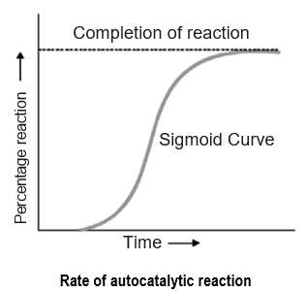
Autocatalysis
The curve plotted between reaction rate and time shows a maximum when the reaction is complete.

Slide 6
Promoter
A substance which, though itself not a catalyst, promotes the activity of a catalyst is called a promoter. They are substances when added in small concentrations can increase the activity of a catalyst.

Slide 7
Catalytic poison
A substance which destroys the activity of the catalyst is called a poison and the process is called Catalytic Poisoning.

Slide 8
Types of Catalytic Poison
✔ Temporary Poisoning
Catalyst regains its activity when the poison is removed from the reaction.
✔ Permanent Poisoning
Catalyst cannot regain its activity even if the catalytic poison is removed.
Eg. As₂O₃ poisons catalyst Pt permanently in manufacturing of SO₃.

Slide 9
Acid and base catalysis
A number of homogeneous catalytic reactions are known which are catalysed by acids or bases, or both acids and bases. These are often referred to as Acid-Base catalysts

Slide 10

Acid and base catalysis
Mechanism: Acid catalysis

Slide 11

Acid and base catalysis
Mechanism: Base catalysis

Slide 12
Biological catalyst - enzymes
Enzymes are protein molecules which act as catalysts to speed up organic reactions in living cells. The catalysis brought about by enzymes is known as Enzyme Catalysis.

Slide 13
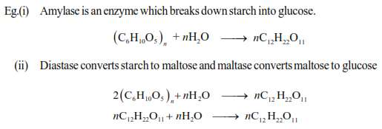
Biological catalyst - enzymes

Slide 14
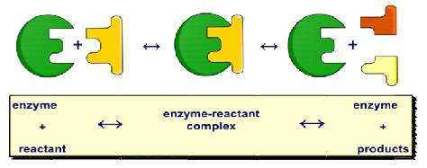
Biological catalyst - enzymes

Slide 15
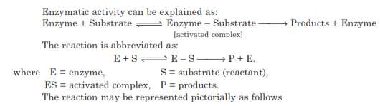
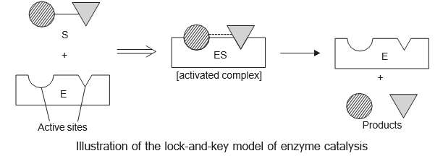
Biological catalyst - enzymes

Slide 16
Applications of catalysis
Catalytic Converters
A device incorporated in the exhaust system of a motor vehicle, containing a catalyst for converting pollutant gases into less harmful ones.

Slide 17
Applications of catalysis
Catalytic Converters
Catalytic converters are used for mitigating automobile exhaust emissions. Catalytic converters are used within internal combustion engines fuelled by either petrol (gasoline) or diesel.
It converts three harmful substances into harmless ones:
1. carbon monoxide (a poisonous gas) into carbon dioxide
2. nitrogen oxides (cause acid rain and smog) into nitrogen and oxygen and
3. hydrocarbons (cause smog and respiratory problems) into carbon dioxide and water.

Slide 18
Applications of catalysis
Catalytic Converters
Catalytic converters consist of a stainless steel box attached to the muffler and containing ceramic beads or honeycomb coated with catalysts (Expensive metals like platinum, Palladium, Rhodium are used. Alumina, Ceria can also be used when combined with expensive metals.)

Slide 19
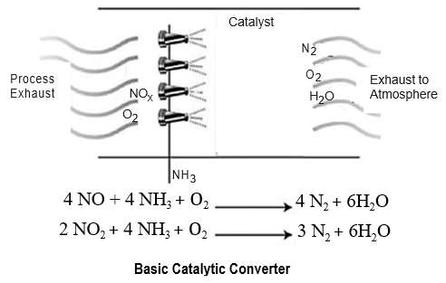
Applications of catalysis
Catalytic Converters

Slide 20
Applications of catalysis
Other applications:
Petroleum refining
Chemical and petrochemicals

